Slide 1
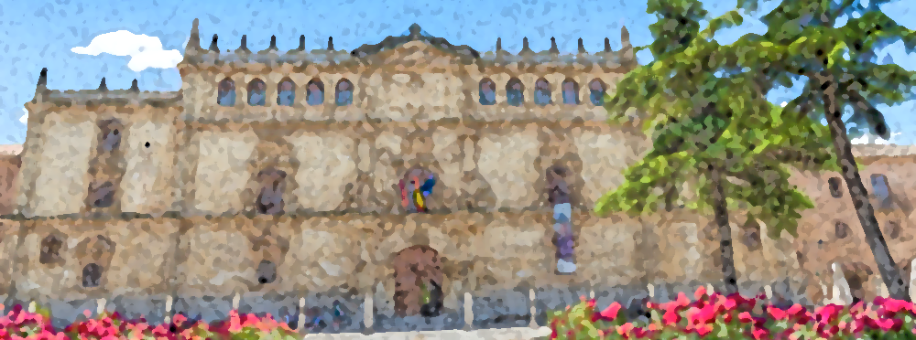
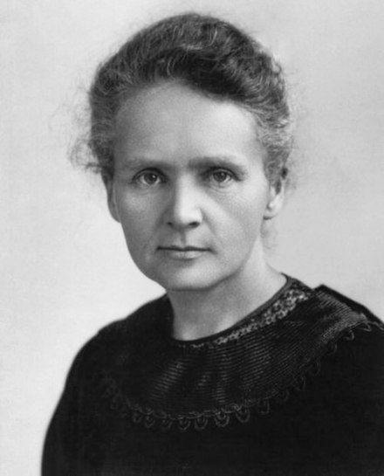
Experiences of Evaluating Marie Skłodowska-Curie Actions Postdoctoral Fellowships (PF)
Dr Christopher J. Whiteoak
(christopher.whiteoak@uah.es)
04/04/2024

Slide 2
Disclaimer
Everything I say today is a personal opinion about the reviewing process in general and does not relate to any specific calls or applications

Slide 3
Profile:
(Comunidad de Madrid supported Programa de Atracción de Talento 2019: Modalidad 1)
May or may not
have had MSCA PF…
(lists of experts are published)

Slide 4
The process…
Expert Reviewing
Submission
Allocation
Individual review
Consensus discussion

Slide 5
Declaration of conflicts of interest
Impartiality is very important and taken very seriously…

Slide 6
Three main actors in the evaluation process
Evaluators: draft the Individual Evaluation Report (IER) and actively participate in the consensus discussion leading to the finalization of the Consensus Report (CR)
Rapporteurs: after drafting their IER, they draft the Consensus Report (CR), moderate the consensus discussion, suggest a CR score, and integrate comments from the other two Evaluators in the CR
Vice-Chairs: are experienced Evaluators with in-depth knowledge of the MSCA evaluation process who assist with the allocation of experts to proposals and with expert monitoring. They do not evaluate the proposals but perform a quality checks of the IERs and the CRs prepared by the Evaluators and the Rapporteurs

Slide 7
The initial Independent Expert Review (IER)
Proposals are evaluated against a list of criteria (three independent reviews)
[1] Excellence…
[2] Impact..
[3] Implementation…

Slide 8
The initial Independent Expert Review (IER)
The easier it is for reviewers to identify the points required, the better…
Evaluators cannot put vague
comments – they must be
“complete descriptions”
Comments must not avoid
anything that could be
“challenged”

Slide 9
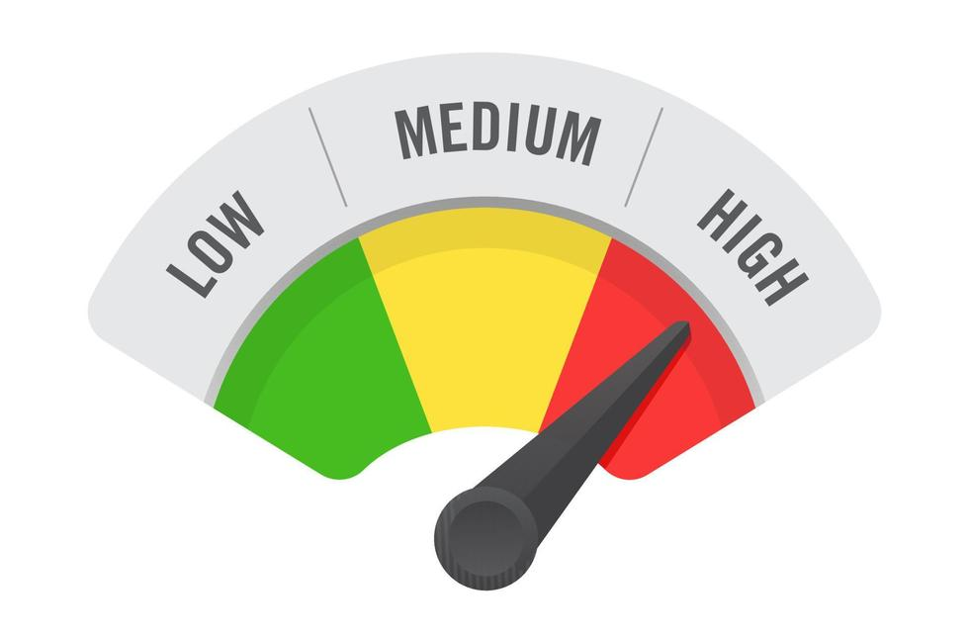
Excellence…
At first glance most are:
The level is very high…

Slide 10
Excellence…
However:
Nothing is perfect. A list of strengths and weaknesses is made
All proposals have strengths and weaknesses…
(some may be ”soft/weak” weaknesses / strengths)

Slide 11
Excellence…
What extent the work goes beyond the state-of-the-art
(incremental work does not fare well here)
Are you promising too much?
(from experience it is difficult to save the world in 2 years…) Be realistic, but ambitious at the same time
Is the methodology sound?
(You should convince the reviewer that your approach is suitable and will achieve the results you are promising) WARNING: AI might sound great, but is hard to sell correctly

Slide 12
Excellence…
Does the project involve interdisciplinarity
(If so, explain the importance)
How are you going to make your findings available?
(You need to go beyond the minimum requirements of European funding)
Is that all in excellence?

Slide 13
No… There is a lot more to do…
Is the supervisor/supervision of a suitable level/experience?
(The theory being that you should learn from their excellence)
Are you going to develop as a researcher?
(This is funding is not just about getting the results - it is about training future researchers to the highest level…)
Is the training well designed?
(How are you going to help the host research
Group? - it is not just one-way traffic)

Slide 14
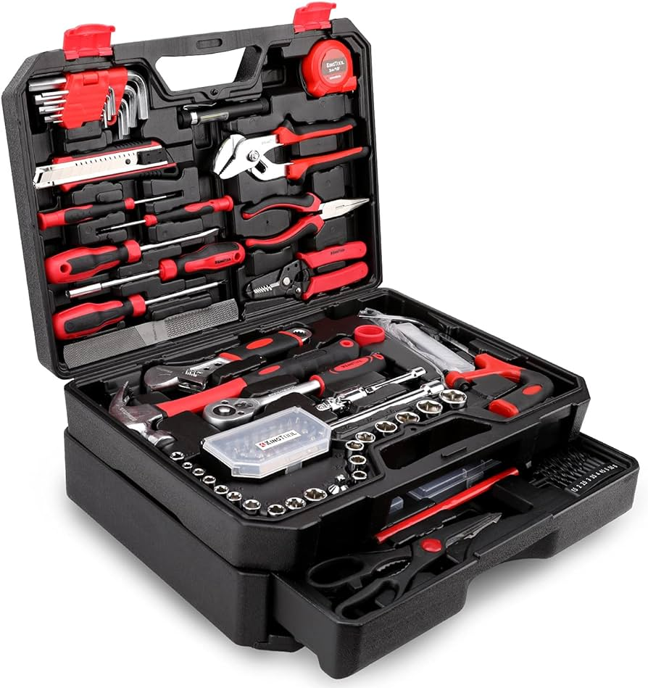
And finally… You…
Do you show potential to work at the highest level in the future?
(Your CV should evidence this through outputs)
Are you appropriate?
(You need to bring something different,
but you must have the basic (and maybe
advanced) skills to ensure that the
research will be a success…)

Slide 15
Impact…
How will this experience and the results obtained help you?
(What's the point in giving you the money?)
What are the expected outcomes and impacts
(How are you going to positively impact science/society and economy? How will you protect the outcomes/results? Quantification?)
Exactly how are you going to share your outcomes?
(How will the public know what you are doing? WARNING: Be specific and avoid generic comments – no copy and paste)

Slide 16
Impact…
Be credible
(Any quantifiable expected impacts should be reasonable and not over inflated)
Impacts beyond the immediate project?
(Convincingly explain what impacts may help the continuation of the work related to the project. How might it change the state-of-the-art?)

Slide 17
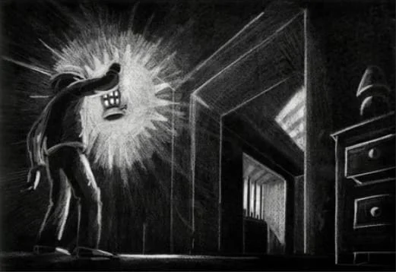
Implementation…
Is the host institution suitable
(Is the infrastructure and non-scientific support of a suitable level to achieve all the aims of the proposal?)
Integration
(You will spend an extended period in
the post (two years), how will you be
made to feel at home and what are
the specific details of this? WARNING:
this is forgotten about in a lot of applications!

Slide 18
Implementation…
The work plan
(Make sure the work plan is sufficiently detailed and that it addresses the main challenges of the research)
Timings
(Is a reasonable time given to each task?)
Risks
(Make sure that reasonable risks are identified - what could go wrong and how will you correct it so not to endanger the proposed outcomes)

Slide 19
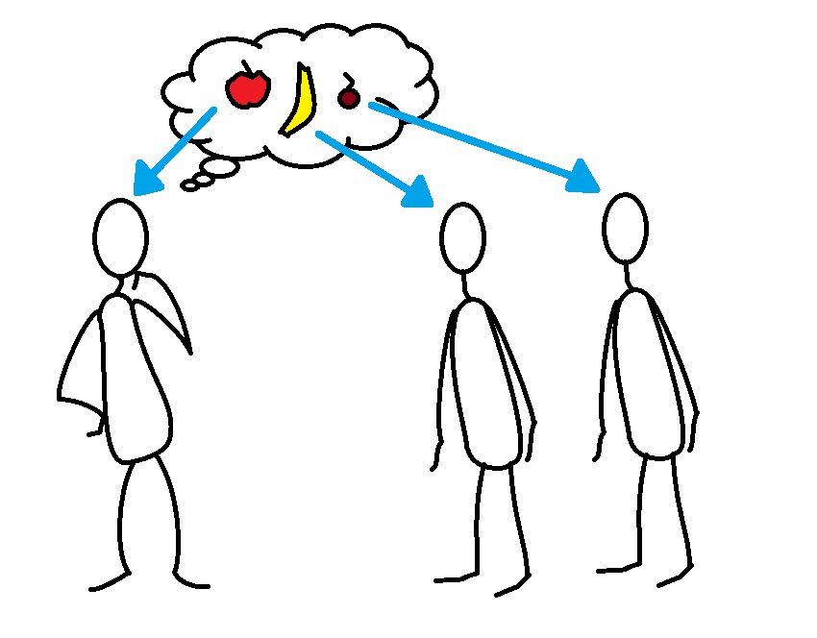
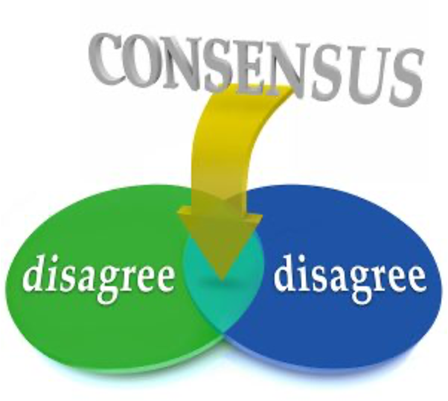
The next stage…
Creating the Consensus Report (CR)
One of the more experienced evaluators will be selected to combine the three IER’s
Three people's opinions are often very distinct…
Discussion (LOTS) is required to reach consensus
This is the hardest part of
the process in my opinion…

Slide 20
Consensus
Finally, agreement on final scores based on the consensus report comments

Slide 21
Summary
The proposal should be excellent in terms of proposed results and outputs (the minimum required level)
The training of the researcher is incredibly important and should be coherent and extremely well explained
The methodology should be appropriate and well described (all variables mentioned) - potential risks should be identified, and appropriate corrective measures proposed
Make sure you bring something to the host!

